Slide 1
Syntax Analysis

Slide 2
Bottom-Up Parsing
Bottom-up parsers build parse trees from the leaves and work up to the root.
• Bottom-up syntax analysis known as shift-reduce parsing.
• An easy-to-implement shift-reduce parser is called operator precedence parsing.
• General method of shift-reduce parsing is called LR parsing.
• Shift-reduce parsing attempts to construct a parse tree for an input string beginning at the leaves (the bottom) and working up towards the root (the top).
• At each reduction step a particular substring matching the right side of a production is replaced by the symbol on the left of that production, and if the substring is chosen correctly at each step, a rightmost derivation is traced out in reverse.

Slide 3
Bottom-Up Parsing
A bottom-up parser creates the parse tree of the given input starting from leaves towards the root
A bottom-up parser tries to find the right-most derivation of the given input in the reverse order.
S ⇒ ... ⇒ ω (the right-most derivation of ω)
← (the bottom-up parser finds the right-most derivation in the reverse order)

Slide 4
Examples
Consider the grammar
S → aABe
A → Abc | b
B → d
The sentence abbcde can be reduced to S by the following steps.
abbcde
aAbcde
aAde
aABe
S
These reductions trace out the following rightmost derivation in reverse.
S → aABe → aAde → aAbcde → abbcde

Slide 5
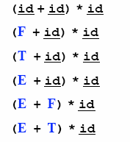
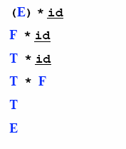
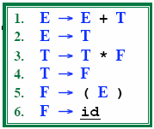
Reduction
A reduction step replaces a specific substring (matching the body of a production)
Reduction is the opposite of derivation
Bottom up parsing is a process of reducing a string ω
to the start symbol S of the grammar

Slide 6
Handle
Informally, a handle is a substring (in the parsing string) that matches the right side of a production rule.
– But not every substring matches the right side of a production rule is handle
A handle of a right sentential form γ (≡ αβω) is a production rule A → β and a position of γ
where the string β may be found and replaced by A to produce the previous right-sentential form in a rightmost derivation γ .
S ⇒ αAω ⇒ αβω

Slide 7
Handle Pruning
A right-most derivation in reverse can be obtained by
handle-pruning.
n-th right-sentential form
rm rm rm rm rm
S=γ₀ ⇒ γ₁ ⇒ γ₂ ⇒ ... ⇒ γ_{n-1} ⇒ γ_{n}= ω
input string
Start from γ_{n}, find a handle A_{n}→β_{n} in γ_{n}, and replace β_{n} in by A_{n} to get γ_{n-1}.
Then find a handle A_{n-1}→β_{n-1} in γ_{n-1}, and replace β_{n-1} in by A_{n-1} to get γ_{n-2}.
Repeat this, until we reach S.

Slide 8
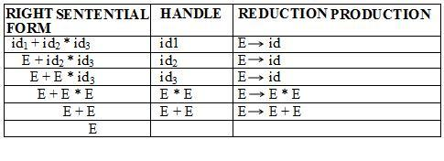
Examples
Example for right sentential form and handle for grammar
E → E + E
E → E * E
E → ( E )
E → id

Slide 9
Shift-Reduce Parsing
Bottom-up parsing is also known as shift-reduce parsing because its two main actions are shift and reduce.
data structures: input-string and stack
Operations
At each shift action, the current symbol in the input string is pushed to a stack.
At each reduction step, the symbols at the top of the stack (this symbol sequence is the right side of a production) will replaced by the non-terminal at the left side of that production.
Accept: Announce successful completion of parsing
Error: Discover a syntax error and call error recovery

Slide 10

Shift-Reduce Parsers
There are two main categories of shift-reduce parsers
1. Operator-Precedence Parser
– simple, but only a small class of grammars.
CFG LR LALR
SLR
LR-Parsers
covers wide range of grammars.
SLR – simple LR parser
LR – most general LR parser
LALR – intermediate LR parser (lookhead LR parser)
SLR, LR and LALR work same, only their parsing tables are different.

Slide 11
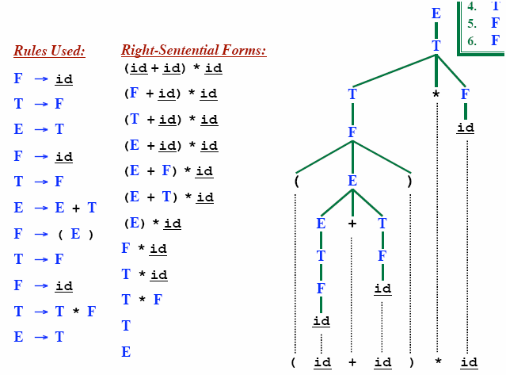
Rightmost Derivation In reverse
LR parsing corresponds to rightmost derivation in reverse

Slide 12
Shift Reduce Parsing
_{Remaining input: abbcde}
S → a T R e
T → T b c | b
R → d
Rightmost derivation:
S ➔ a T R e
➔ a T d e
➔ a T b c d e
➔ a b b c d e

Slide 13
Shift Reduce Parsing
_{Remaining input: bcde}
S → a T R e
T → T b c | b
R → d
➔
_{Shift a, Shift b}
_{a b}
Rightmost derivation:
S ➔ a T R e
➔ a T d e
➔ a T b c d e
➔ a b b c d e

Slide 14
Shift Reduce Parsing
_{Remaining input: bcde}
S → a T R e
T → T b c | b
R → d
➔
_{Shift a, Shift b}
_{Reduce T → b}
➔
_{T}
_{a b}
Rightmost derivation:
S ➔ a T R e
➔ a T d e
➔ a T b c d e
➔ a b b c d e

Slide 15
Shift Reduce Parsing
_{Remaining input: de}
S → a T R e
T → T b c | b
R → d
➔
_{Shift a, Shift b}
_{Reduce T → b}
_{Shift b, Shift c}
➔
_{T}
➔
_{a b}
_{b c}
Rightmost derivation:
S ➔ a T R e
➔ a T d e
➔ a T b c d e
➔ a b b c d e

Slide 16
Shift Reduce Parsing
_{Remaining input: de}
S → a T R e
T → T b c | b
R → d
_{T}
➔
_{Shift a, Shift b}
_{Reduce T → b}
_{Shift b, Shift c}
_{Reduce T → T b c}
➔
_{T}
➔
➔
_{a b}
_{b c}
Rightmost derivation:
S ➔ a T R e
➔ a T d e
➔ a T b c d e
➔ a b b c d e

Slide 17
Shift Reduce Parsing
_{Remaining input: e}
S → a T R e
T → T b c | b
R → d
_{T}
➔
_{Shift a, Shift b}
_{Reduce T → b}
_{Shift b, Shift c}
_{Reduce T → T b c}
_{Shift d}
➔
_{T}
➔
➔
➔
_{a b}
_{b c}
_{d}
Rightmost derivation:
S ➔ a T R e
➔ a T d e
➔ a T b c d e
➔ a b b c d e

Slide 18
Shift Reduce Parsing
_{Remaining input: e}
S → a T R e
T → T b c | b
R → d
_{T}
➔
_{Shift a, Shift b}
_{Reduce T → b}
_{Shift b, Shift c}
_{Reduce T → T b c}
_{Shift d}
_{Reduce R → d}
➔
_{T}
_{R}
➔
➔
➔
_{a b}
_{b c}
_{d}
➔
Rightmost derivation:
S ➔ a T R e
➔ a T d e
➔ a T b c d e
➔ a b b c d e

Slide 19
Shift Reduce Parsing
_{Remaining input:}
S → a T R e
T → T b c | b
R → d
_{T}
➔
_{Shift a, Shift b}
_{Reduce T → b}
_{Shift b, Shift c}
_{Reduce T → T b c}
_{Shift d}
_{Reduce R → d}
_{Shift e}
➔
_{T}
_{R}
➔
➔
➔
_{a b}
_{b c}
_{d}
_{e}
➔
Rightmost derivation:
S ➔ a T R e
➔ a T d e
➔ a T b c d e
➔ a b b c d e
➔

Slide 20
Shift Reduce Parsing
_{Remaining input:}
S → a T R e
T → T b c | b
R → d
_{S}
_{T}
➔
_{Shift a, Shift b}
_{Reduce T → b}
_{Shift b, Shift c}
_{Reduce T → T b c}
_{Shift d}
_{Reduce R → d}
_{Shift e}
_{Reduce S → a T R e}
➔
_{T}
_{R}
➔
➔
➔
_{a b}
_{b c}
_{d}
_{e}
➔
Rightmost derivation:
S ➔ a T R e
➔ a T d e
➔ a T b c d e
➔ a b b c d e
➔
➔

Slide 21
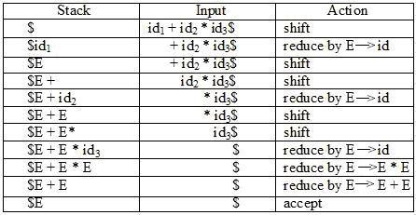
Example Shift-Reduce Parser
E → E + E
E → E * E
E → ( E )
E → id

Slide 22
Conflicts during shift-reduce parsing
There are CFGs for which the parser cannot decide whether to shift or to reduce (a shift-reduce conflict), or cannot decide which of several reductions to make (a reduce/reduce conflict), by knowing the entire stack contents and the next input symbol.
Example of such grammars:
· Grammars used in compiling usually fall in the LR(1) class, with one symbol lookahead.
· An ambiguous grammar can never be LR.
Stmt → if expr then stmt
| if expr then stmt else stmt
| other
There is a shift/reduce conflict occur for some input string.
· So this is not LR(1) grammar.

Slide 23
What are the conflicts in shift reduce parsing?
· Shift/Reduce conflict: The entire stack contents and the next input symbol cannot decide whether to shift or reduce.
· Reduce/Reduce conflict: The entire stack contents and the next input symbol cannot decide which of several reductions to make.
Conflicts arise from ambiguities in the grammar. That is, some input sequences may possess more than one parse. Shift/reduce conflicts are easily resolved (Happy automatically selects the shift action, as this is usually the intended one). Reduce/reduce conflicts are more serious. A reduce/reduce conflict implies that a certain sequence of tokens on the input can represent more than one non-terminal, and the parser is uncertain as to which reduction rule to use. It will select the reduction rule uppermost in the grammar file, so if you really must have a reduce/reduce conflict you can select which rule will be used by putting it first in your grammar file.
https://www.youtube.com/watch?v=QI6sMQodlQc

Slide 24
exp : exp op exp0|exp0
exp0 : if exp then exp else exp | atom
atom : var | integer | '(' exp ')' ...
This grammar has a shift/reduce conflict, due to the following ambiguity. In an input such as
if 1 then 2 else 3 + 4
the grammar doesn't specify whether the parse should be if 1 then 2 else (3 + 4)
Or (if 1 then 2 else 3) + 4
reformulate the exp rule as: exp : atom op exp | exp0
and this removes the conflict, but at the expense of some stack space while parsing (we turned a left-recursion into a right-recursion).

Slide 25
LR Parser
The LR parser is a non-recursive, shift-reduce, bottom-up parser
It uses a wide class of context-free grammar which makes it the most efficient syntax analysis technique
LR parsers are also known as LR(k) parsers
where L stands for left-to-right scanning of the input stream;
R stands for the construction of right-most derivation in reverse, and
k denotes the number of look ahead symbols to make decisions

Slide 26
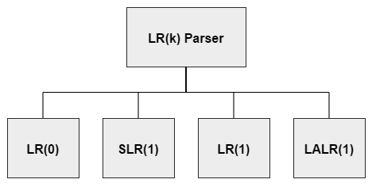
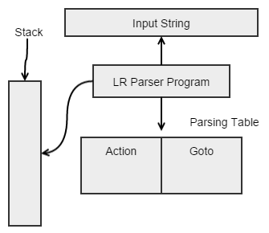
LR Parser

Slide 27
LR Parsers
LR parsing is attractive because:
LR parsing is most general non-backtracking shift-reduce parsing,
yet it is still efficient
An LR-parser can detect a syntactic error as soon as it is possible to do so a left-to-right scan of the input
LR parsers can be constructed to recognize virtually all programming language constructs for which CFG grammars can be written
Drawback of LR method:
Too much work to construct LR parser by hand
Fortunately tools (LR parsers generators) are available

Slide 28
Kinds of Parsers
Top-Down (Predictive Parsing) LL
Bottom-Up LR
LR (shift reduce) is more powerful than LL (predictive parsing)
Can detect a syntactic error as soon as possible
LR is difficult to do by hand (unlike LL)

Slide 29
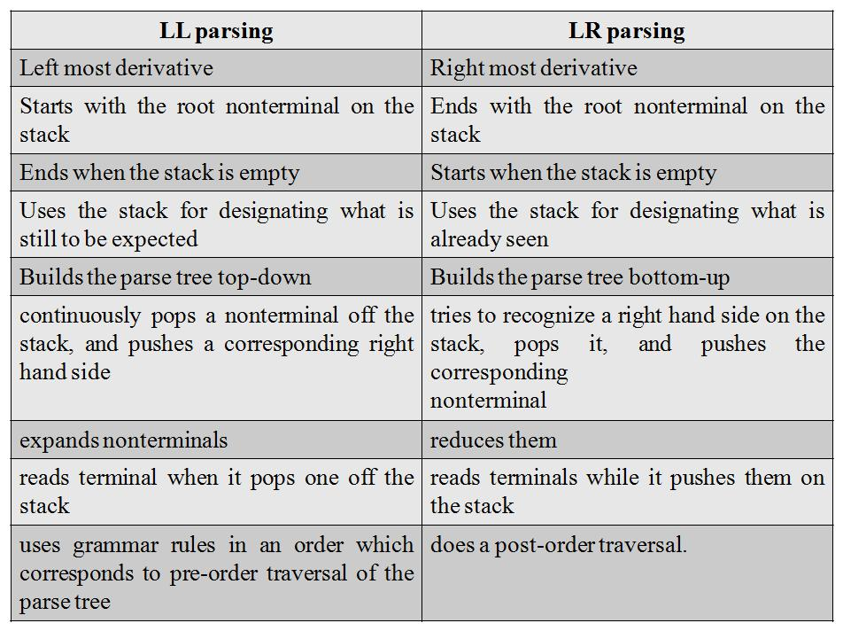

Slide 30
Example Shift-Reduce Parsing
Consider the grammar:
Stack
Input
Action
$ | id₁ + id₂$ | shift
$id₁ | + id₂$ | reduce 6
$F | + id₂$ | reduce 4
$T | + id₂$ | reduce 2
$E | + id₂$ | shift
$E + | id₂$ | shift
$E + id₂ |  | reduce 6
$E + F |  | reduce 4
$E + T |  | reduce 1
$E |  | accept

Slide 31
Conflicts During Shift-Reduce Parsing
There are context-free grammars for which shift-reduce parsers cannot be used.
Stack contents and the next input symbol may not decide action:
shift/reduce conflict: Whether make a shift operation or a reduction
reduce/reduce conflict: The parser cannot decide which of several reductions to make
If a shift-reduce parser cannot be used for a grammar, that grammar is called as non-LR(k) grammar.
left to right scanning
right-most derivation
k lookhead
An ambiguous grammar can never be a LR grammar.

Slide 32
Constructing SLR Parsing Tables – LR(0) Item
An item indicates how much of a production we have seen at a given point in the parsing process
For Example the item A → X • YZ
We have already seen on the input a string derivable from X
We hope to see a string derivable from YZ
For Example the item A → • XYZ
We hope to see a string derivable from XYZ
For Example the item A → XYZ •
We have already seen on the input a string derivable from XYZ
It is possibly time to reduce XYZ to A
Special Case:
Rule: A → ε yields only one item A → •

Slide 33
Constructing SLR Parsing Tables
A collection of sets of LR(0) items (the canonical LR(0) collection) is the basis for constructing SLR parsers.
Canonical LR(0) collection provides the basis of constructing a DFA called LR(0) automaton
This DFA is used to make parsing decisions
Each state of LR(0) automaton represents a set of items in the canonical LR(0) collection
To construct the canonical LR(0) collection for a grammar
Augmented Grammar
CLOSURE function
GOTO function

Slide 34
Constructing SLR Parsing Tables – LR(0) Item
An LR(0) item of a grammar G is a production of G with a dot at some position of the right side.
Ex: | A → aBb | Possible LR(0) Items: | A → • aBb
 |  | (four different possibility) | A → a • Bb
 |  |  | A → aB • b
 |  |  | A → aBb •
Sets of LR(0) items will be the states of action and goto table of the SLR parser.
– States represent sets of “items”
LR parser makes shift-reduce decision by maintaining states to keep track of where we are in a parsing process

Slide 35
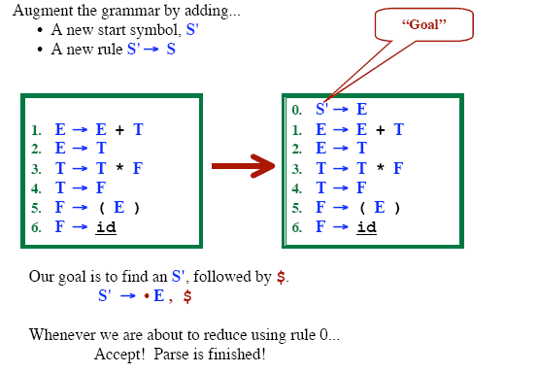
Grammar Augmentation

Slide 36
The Closure Operation
If I is a set of LR(0) items for a grammar G, then closure(I) is the set of LR(0) items constructed from I by the two rules:
Initially, every LR(0) item in I is added to closure(I).
If A → α.Bβ is in closure(I) and B→γ is a production rule of G;
then B→.γ will be in the closure(I).
We will apply this rule until no more new LR(0) items can be added to closure(I).

Slide 37
The Closure Operation -- Example
closure({E' → .E}) =
E' → E
E → E+T | { | E' → •E kernel items
E → T |  | E → •E+T
T → T*F |  | E → •T
T → F |  | T → •T*F
F → (E) |  | T → •F
F → id |  | F → •(E)
 |  | F → •id }

Slide 38
GOTO Operation
If I is a set of LR(0) items and X is a grammar symbol (terminal or non-terminal), then GOTO(I,X) is defined as follows:
– If A → α • Xβ in I
then every item in closure({A → αX • β}) will be in GOTO(I,X).
Example:
I ={ E’ → • E, E → • E+T,
T → • T*F, T → • F, F → • (E), F → • id }
E → • T,
GOTO(I,E) = { E’ → E • , E → E • +T } GOTO(I,T) = { E → T • , T → T • *F } GOTO(I,F) = {T → F • }
GOTO(I,() = { F → (• E), E → • E+T, E →
F → • (E), F → • id } GOTO(I,id) = { F → id • }
• T, T → • T*F, T → • F,

Slide 39
Construction of The Canonical LR(0) Collection (CC)
To create the SLR parsing tables for a grammar G, we will create the canonical LR(0) collection of the grammar G’.
Algorithm:
C is { closure({S'→ • S}) }
repeat the followings until no more set of LR(0) items can be added to C.
for each I in C and each grammar symbol X
if GOTO(I,X) is not empty and not in C
add GOTO(I,X) to C
GOTO function is a DFA on the sets in C.

Slide 40
The Canonical LR(0) Collection -- Example
I₀: E’ → .E E → .E+T | I₁: E’ → E. E → E.+T | I₆: E → E+.T T → .T*F | I₉: E → E+T. T → T.*F
E → .T |  | T → .F
T → .T*F T → .F | I₂: E → T. T → T.*F | F → .(E) F → .id | I₁₀: T → T*F.
F → .(E)
F → .id | I₃: T → F. | I₇: T → T*.F F → .(E) | I₁₁: F → (E).
 | I₄: F → (.E) E → .E+T | F → .id
 | E → .T T → .T*F | I₈: F → (E.) E → E.+T
 | T → .F
 | F → .(E)
 | F → .id
I₅: F → id.

Slide 41
Transition Diagram (DFA) of Goto Function
I₀
E
I₁
+
I₆
T
I₉
to I₃
*
to I₇
F
(
T
_{id} to I₄
to I₅
F
I₂
*
I₇
F (
id
^{I}10
to I₄
to I₅
I₃
(
I₄
id
I₅
E
I₈
to I₂ to I₃ to I₄
)
+
id
T
F
(
^{I}11
to I₆
https://www.youtube.com/watch?v=caGd_-TvPLc

Slide 42
Constructing SLR Parsing Table
(of an augumented grammar G’)
Construct the canonical collection of sets of LR(0) items for G’. C←{I₀,...,I_{n}}
Create the parsing action table as follows:
If a is a terminal, A→α.aβ in I_{i} and goto(I_{i},a)=I_{j} then action[i,a] is shift j.
If A→α. is in I_{i} , then action[i,a] is reduce A→α for all a in FOLLOW(A) where A≠S’.
If S’→S. is in I_{i} , then action[i,$] is accept.
If any conflicting actions generated by these rules, the grammar is not SLR(1).
Create the parsing goto table
for all non-terminals A,
if goto(I_{i},A)=I_{j} then goto[i,A]=j
All entries not defined by (2) and (3) are errors.
Initial state of the parser contains S’→.S

Slide 43
Parsing Tables of Expression Grammar
Action Table
Goto Table
state | id | + | * | ( | ) | $ |  | E | T | F
0 | s5 |  |  | s4 |  |  |  | 1 | 2 | 3
1 |  | s6 |  |  |  | acc
2 |  | r2 | s7 |  | r2 | r2
3 |  | r4 | r4 |  | r4 | r4
4 | s5 |  |  | s4 |  |  |  | 8 | 2 | 3
5 |  | r6 | r6 |  | r6 | r6
6 | s5 |  |  | s4 |  |  |  |  | 9 | 3
7 | s5 |  |  | s4 |  |  |  |  |  | 10
8 |  | s6 |  |  | s11
9 |  | r1 | s7 |  | r1 | r1
10 |  | r3 | r3 |  | r3 | r3
11 |  | r5 | r5 |  | r5 | r5
https://www.youtube.com/watch?v=ZZiVhS4yhi4
https://www.youtube.com/watch?v=APJ_Eh60Qwo

Slide 44
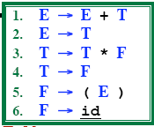
(SLR) Parsing Tables for Expression Grammar
Action Table
Goto Table
state | id | + | * | ( | ) | $ |  | E | T | F
0 | s5 |  |  | s4 |  |  |  | 1 | 2 | 3
1 |  | s6 |  |  |  | acc
2 |  | r2 | s7 |  | r2 | r2
3 |  | r4 | r4 |  | r4 | r4
4 | s5 |  |  | s4 |  |  |  | 8 | 2 | 3
5 |  | r6 | r6 |  | r6 | r6
6 | s5 |  |  | s4 |  |  |  |  | 9 | 3
7 | s5 |  |  | s4 |  |  |  |  |  | 10
8 |  | s6 |  |  | s11
9 |  | r1 | s7 |  | r1 | r1
10 |  | r3 | r3 |  | r3 | r3
11 |  | r5 | r5 |  | r5 | r5
Key to Notation
S4=“Shift input symbol and push state 4”
R5= “Reduce by rule 5” Acc=Accept (blank)=Syntax Error

Slide 45
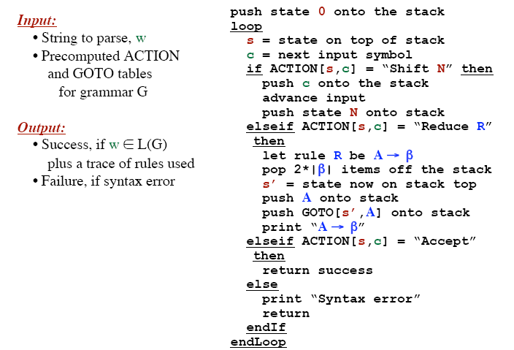
LR Parsing Algorithm

Slide 46
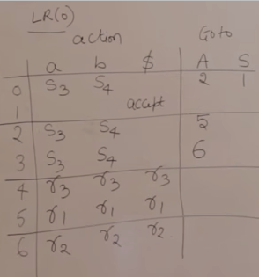
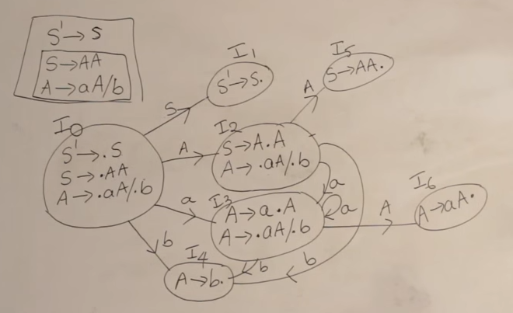
LR(0) item Table Examples

Slide 47
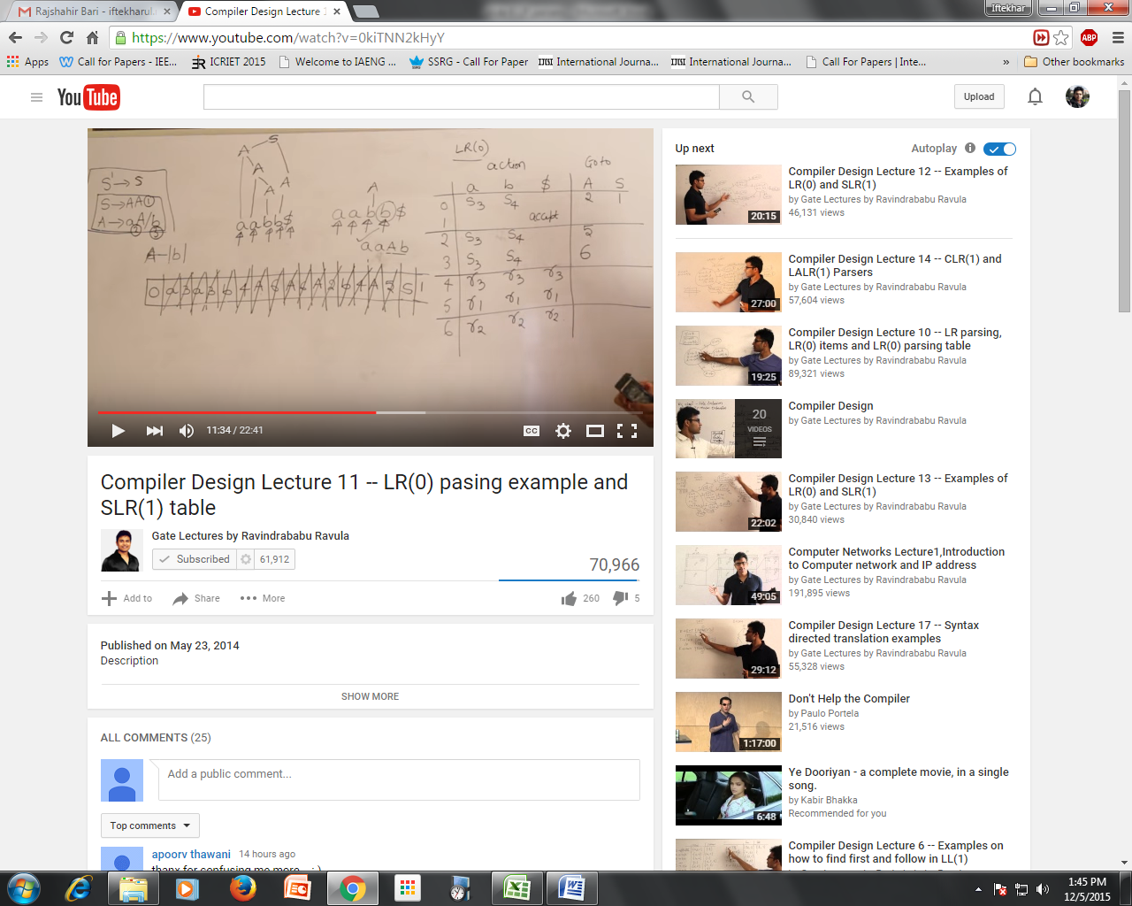
Matching String

Slide 48
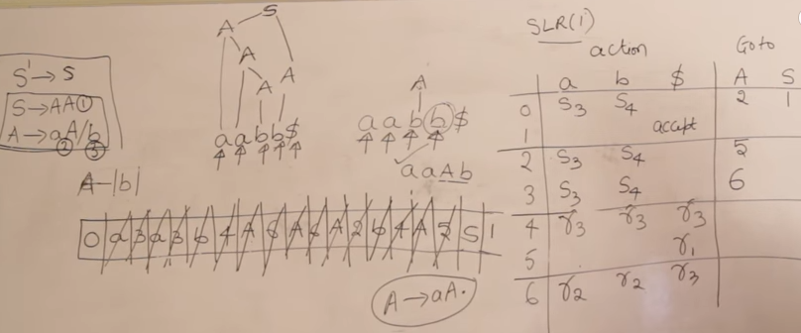
SLR(1) items Table

Slide 49
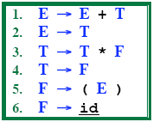

Example LR Parse: (id+id)*id
state | id | + | * | ( | ) | $ |  | E | T | F
0 | s5 |  |  | s4 |  |  |  | 1 | 2 | 3
1 |  | s6 |  |  |  | acc
2 |  | r2 | s7 |  | r2 | r2
3 |  | r4 | r4 |  | r4 | r4
4 | s5 |  |  | s4 |  |  |  | 8 | 2 | 3
5 |  | r6 | r6 |  | r6 | r6
6 | s5 |  |  | s4 |  |  |  |  | 9 | 3
7 | s5 |  |  | s4 |  |  |  |  |  | 10
8 |  | s6 |  |  | s11
9 |  | r1 | s7 |  | r1 | r1
10 |  | r3 | r3 |  | r3 | r3
11 |  | r5 | r5 |  | r5 | r5
https://www.youtube.com/watch?v=NJb-STjE0KY

Slide 50

Example LR Parse: (id+id)*id
state | id | + | * | ( | ) | $ |  | E | T | F
0 | s5 |  |  | s4 |  |  |  | 1 | 2 | 3
1 |  | s6 |  |  |  | acc
2 |  | r2 | s7 |  | r2 | r2
3 |  | r4 | r4 |  | r4 | r4
4 | s5 |  |  | s4 |  |  |  | 8 | 2 | 3
5 |  | r6 | r6 |  | r6 | r6
6 | s5 |  |  | s4 |  |  |  |  | 9 | 3
7 | s5 |  |  | s4 |  |  |  |  |  | 10
8 |  | s6 |  |  | s11
9 |  | r1 | s7 |  | r1 | r1
10 |  | r3 | r3 |  | r3 | r3
11 |  | r5 | r5 |  | r5 | r5
https://www.youtube.com/watch?v=0kiTNN2kHyY&t=6s

Slide 51
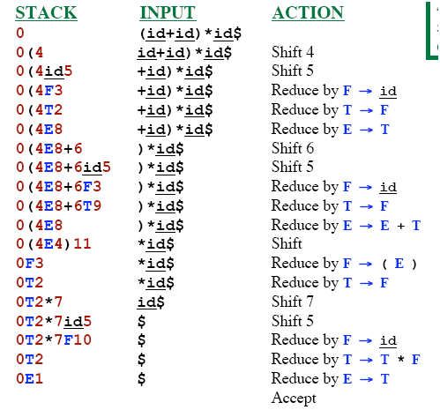
Example LR Parse: (id+id)*id
state | id | + | * | ( | ) | $ |  | E | T | F
0 | s5 |  |  | s4 |  |  |  | 1 | 2 | 3
1 |  | s6 |  |  |  | acc
2 |  | r2 | s7 |  | r2 | r2
3 |  | r4 | r4 |  | r4 | r4
4 | s5 |  |  | s4 |  |  |  | 8 | 2 | 3
5 |  | r6 | r6 |  | r6 | r6
6 | s5 |  |  | s4 |  |  |  |  | 9 | 3
7 | s5 |  |  | s4 |  |  |  |  |  | 10
8 |  | s6 |  |  | s11
9 |  | r1 | s7 |  | r1 | r1
10 |  | r3 | r3 |  | r3 | r3
11 |  | r5 | r5 |  | r5 | r5

Slide 52
SLR Grammar: Review
An LR parser using SLR parsing tables for a grammar G is called as the SLR parser for G.
If a grammar G has an SLR parsing table, it is called SLR grammar (or SLR grammar in short).
Every SLR grammar is unambiguous, but every unambiguous grammar is not a SLR grammar.
If the SLR parsing table of a grammar G has a conflict, we say that that grammar is not SLR grammar.

Slide 53
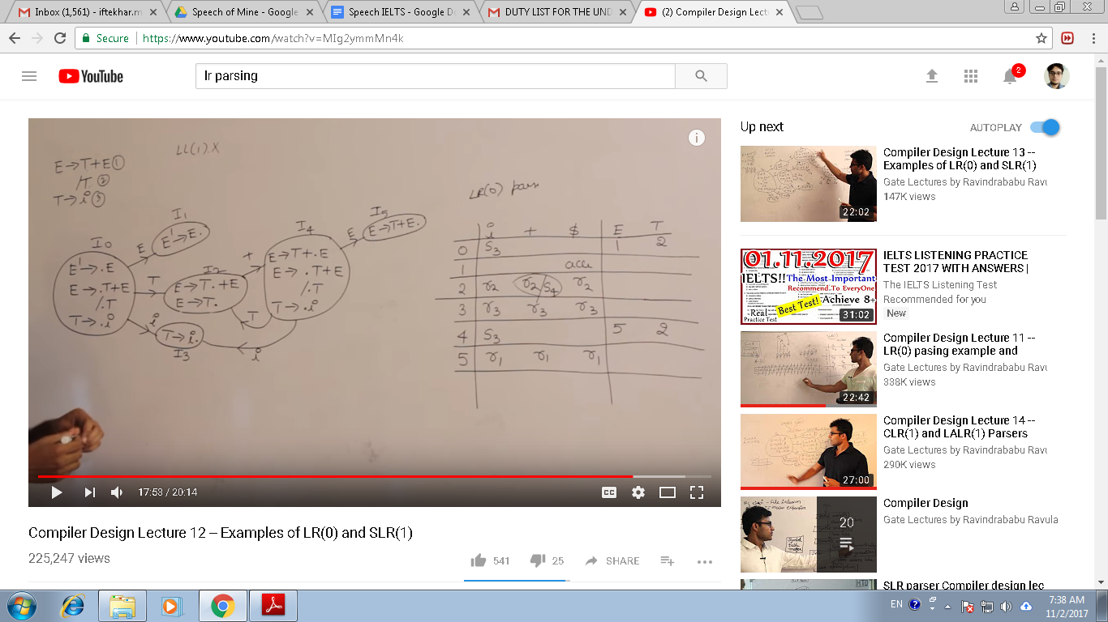
LR(0) conflicts
Not LL(1)
Not LR(0)
https://www.youtube.com/watch?v=MIg2ymmMn4k

Slide 54
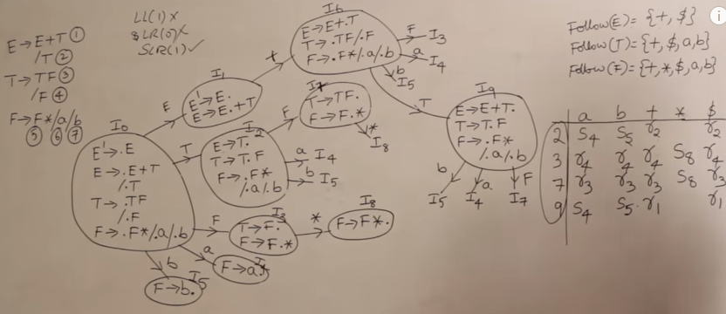
Conflicts
Not LL(1)
Not LR(0) but SLR(1)
https://www.youtube.com/watch?v=5s4CWn6GiwY

Slide 55
Any Questions ?

